Slide 1
The Gravitational N-Body Simulation analysis using Sequential, OpenMP and CUDA
Team Members:
Abhishek N N : 20BCE1025
Mayank Gupta : 20BCE1538

Slide 2
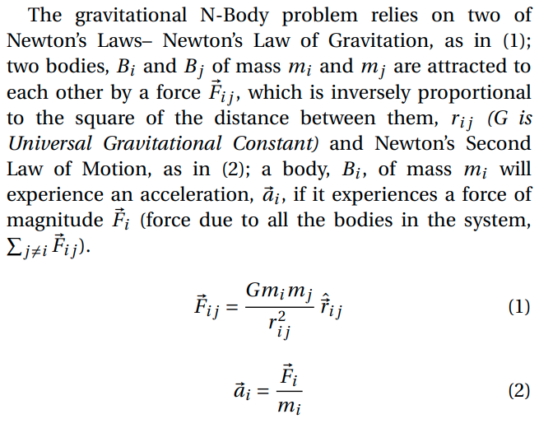
Sequential All-Pairs Algorithm

Slide 3
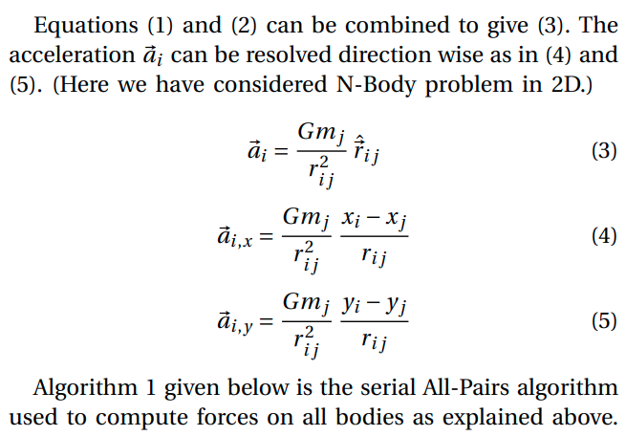

Slide 4
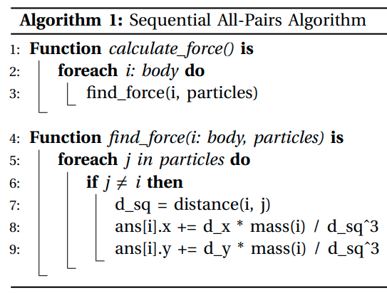
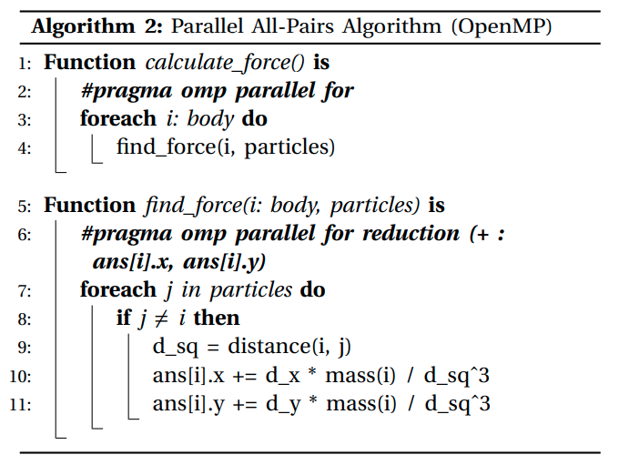

Slide 5
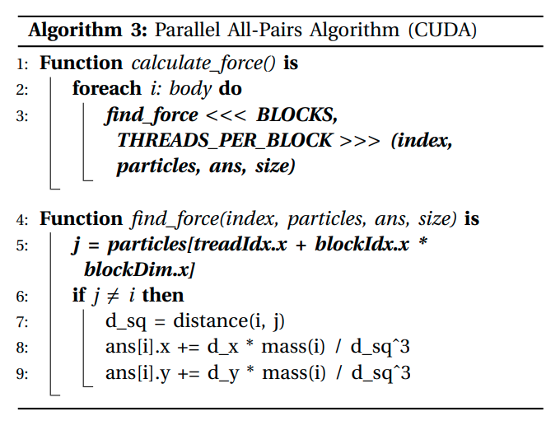

Slide 6
The Barnes-Hut Algorithm
The crucial idea in speeding up the brute force n-body algorithm is to group nearby bodies and approximate them as a single body. If the group is sufficiently far away, we can approximate its gravitational effects by using its center of mass. The center of mass of a group of bodies is the average position of a body in that group, weighted by mass. Formally, if two bodies have positions (x1, y1) and (x2, y2), and masses m1 and m2, then their total mass and center of mass (x, y) are given by:
m = m1 + m2 x = (x1*m1 + x2*m2) / m y = (y1*m1 + y2*m2) / m
CONSTRUCTING THE BARNES-HUT TREE
To construct the Barnes-Hut tree, insert the bodies one after another. To insert a body b into the tree rooted at node x, use the following recursive procedure:
If node x does not contain a body, put the new body b here.
If node x is an internal node, update the center-of-mass and total mass of x. Recursively insert the body b in the appropriate quadrant.
If node x is an external node, say containing a body named c, then there are two bodies b and c in the same region. Subdivide the region further by creating four children.
Then, recursively insert both b and c into the appropriate quadrant(s). Since b and c may still end up in the same quadrant, there may be several subdivisions during a single insertion. Finally, update the center-of-mass and total mass of x.

Slide 7
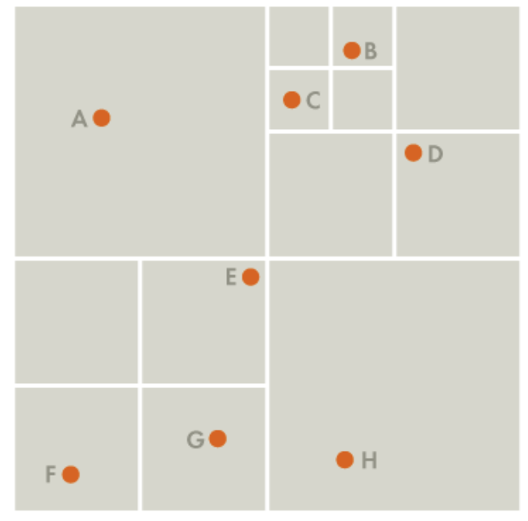
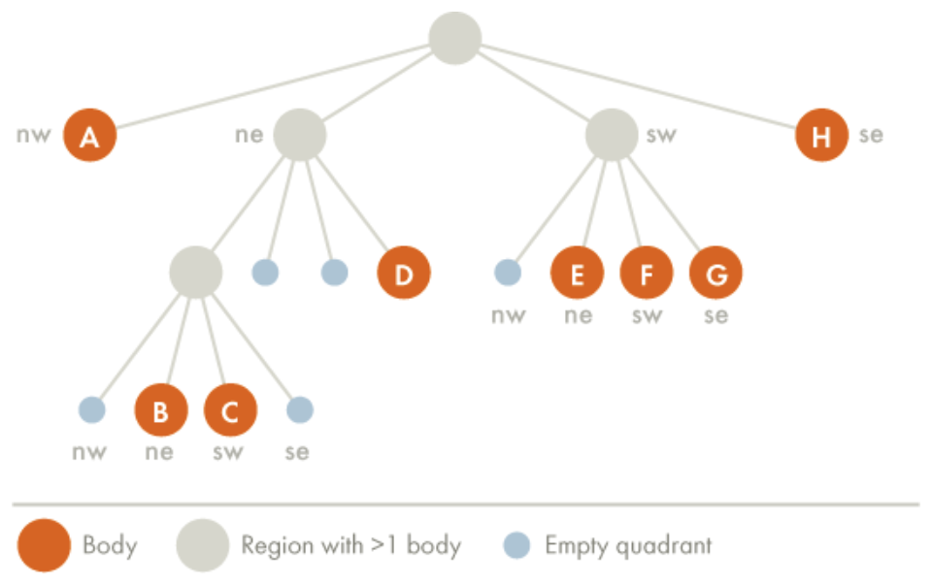

Slide 8
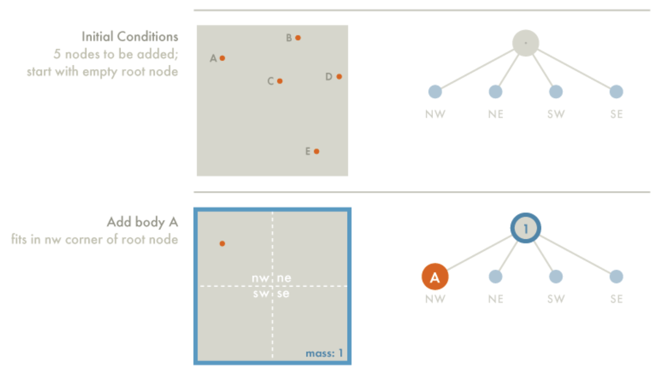

Slide 9
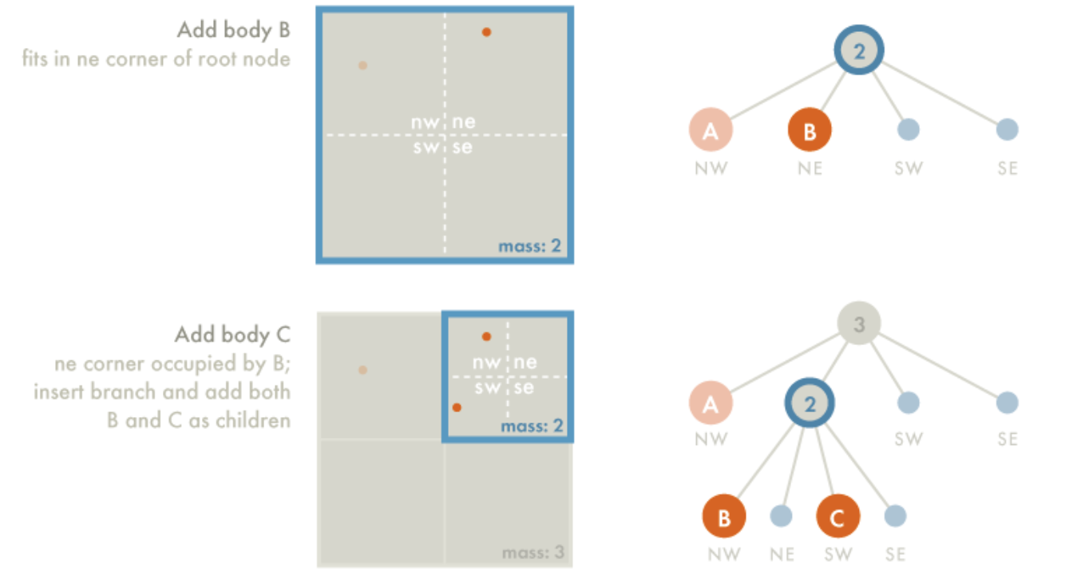

Slide 10
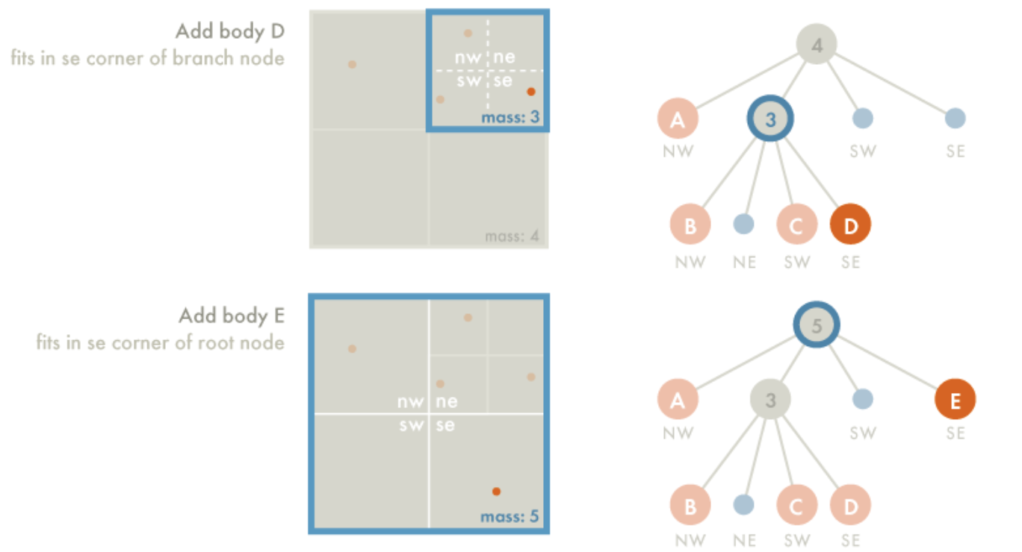

Slide 11
CALCULATING THE FORCE ACTING ON A BODY
To calculate the net force acting on body b, use the following recursive procedure, starting with the root of the quad-tree:
If the current node is an external node (and it is not body b), calculate the force exerted by the current node on b, and add this amount to b’s net force.
Otherwise, calculate the ratio s/d. If s/d < θ, treat this internal node as a single body, and calculate the force it exerts on body b, and add this amount to b’s net force.
Otherwise, run the procedure recursively on each of the current node’s children.
To determine if a node is sufficiently far away, compute the quotient s / d, where s is the width of the region represented by the internal node, and d is the distance between the body and the node’s center-of-mass. Then, compare this ratio against a threshold value θ. If s / d < θ, then the internal node is sufficiently far away. By adjusting the θ parameter, we can change the speed and accuracy of the simulation. We will always use θ = 0.5, a value commonly used in practice. Note that if θ = 0, then no internal node is treated as a single body, and the algorithm degenerates to brute force and if θ is set to big number the root containing all bodies is always considered as single body and all accuracy of the calculation will be fully wrong

Slide 12
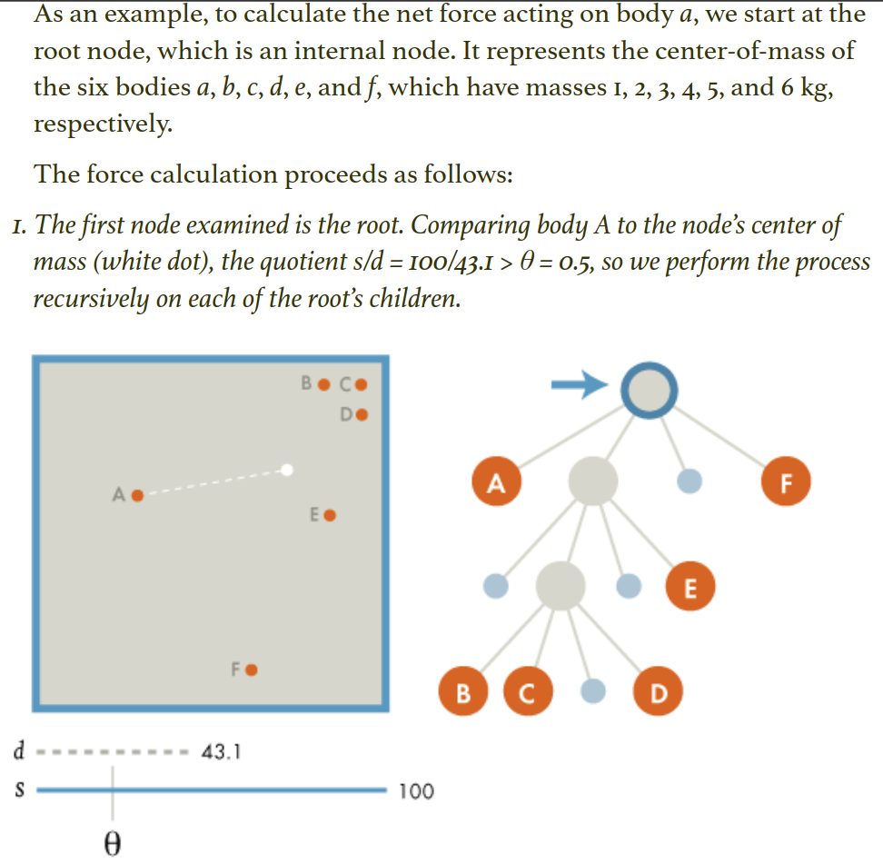

Slide 13
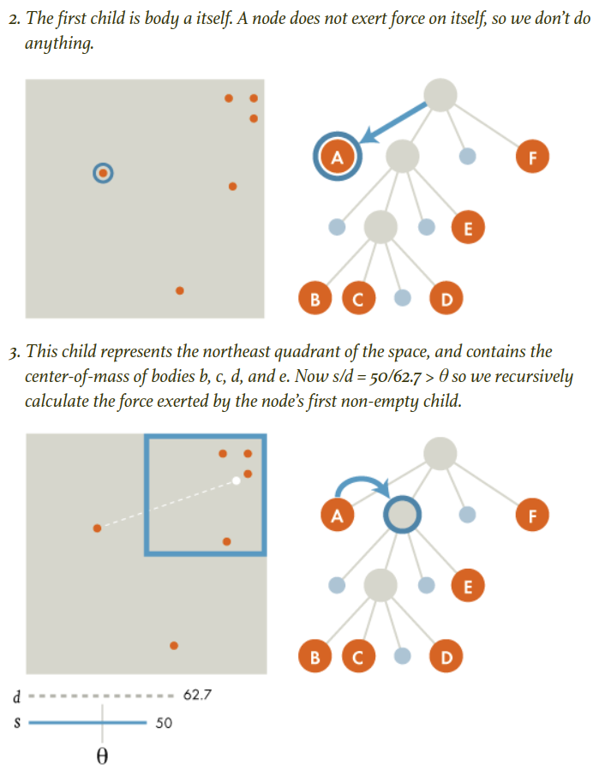

Slide 14
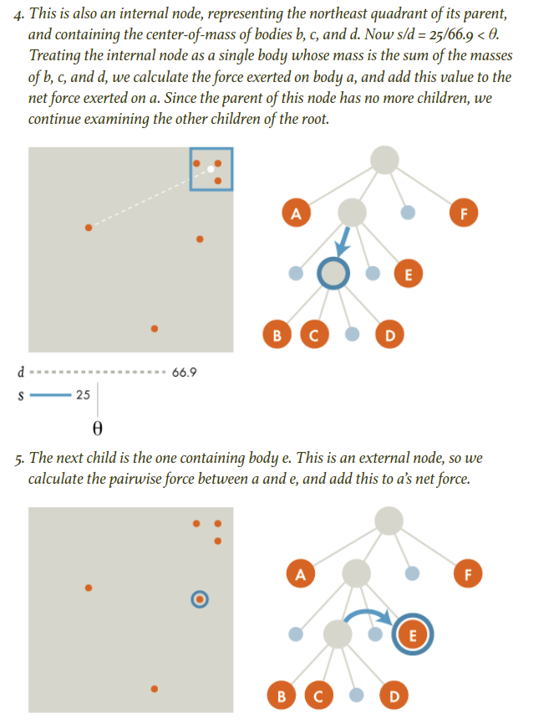

Slide 15
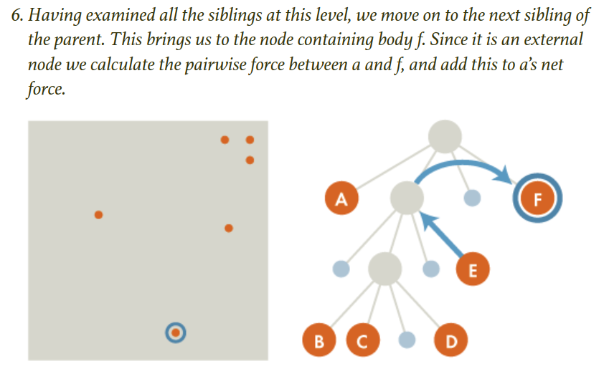

Slide 16
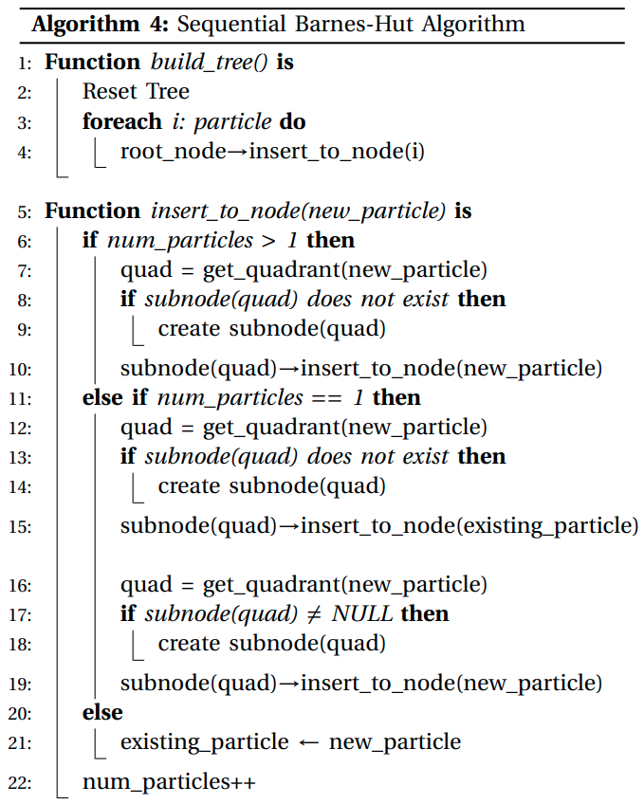
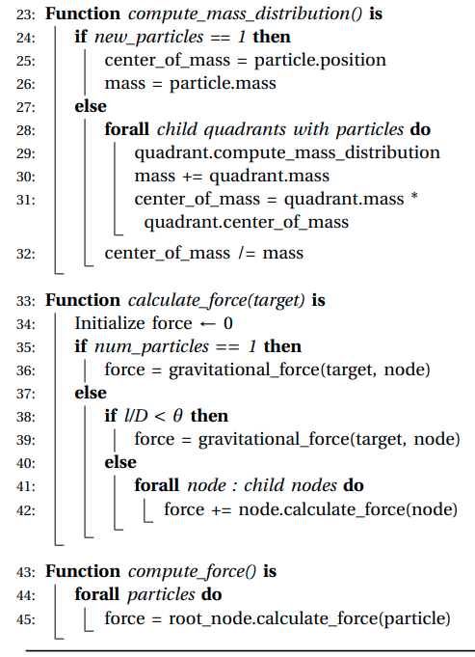

Slide 17
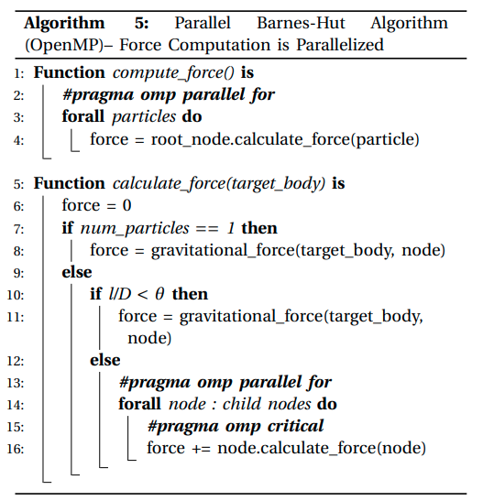

Slide 18
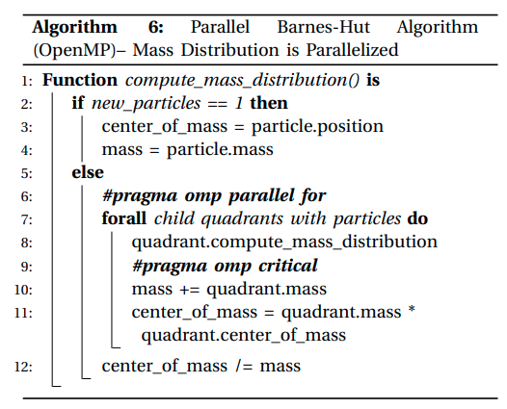

Slide 19
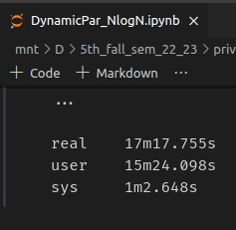
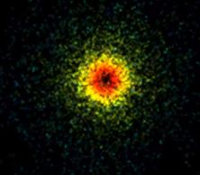

Execution and Outputs

Slide 20
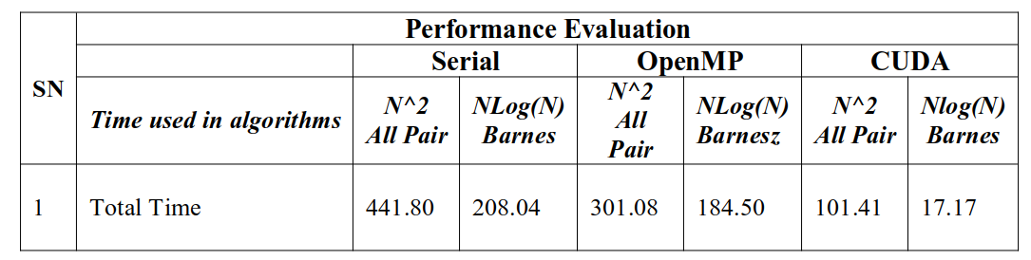
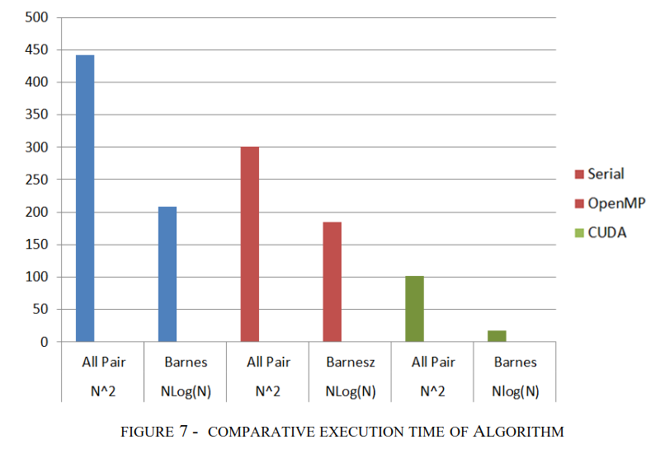

Slide 21
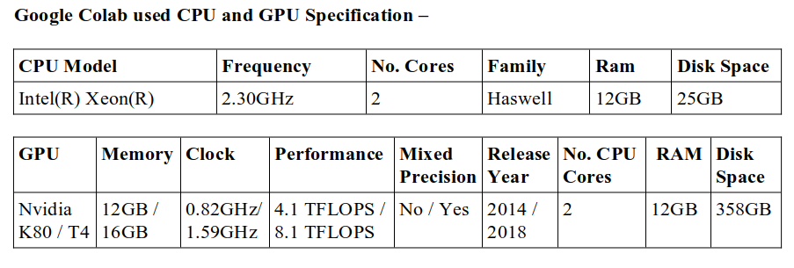

Slide 22
CONCLUSION
As part of our project, we analyzed two algorithms to solve the N-Body problem–
the naive All-Pairs Algorithm
and quad-tree based Barnes-Hut Algorithm
in Serial, OpenMP and CUDA
Compared to the sequential execution we noticed a decrease in execution time in parallelization of sequential algorithm.
The performance of these algorithms can be further bettered by running the algorithms on a CPU and GPU with a higher multiprogramming support.
The parallel direct method scaled linearly with respect to the number of processes.
The communication overhead for the parallel direct method is negligible as the number of stars is so small, but as more processes are added the algorithm becomes plausible for larger numbers of N, but with increasing N will come increasing communication overheads.
Due to limitations with time this project only implemented a simple parallel version of the Barnes- Hut algorithm that contains no load balancing. The computation time of the Parallel Barnes-Hut scaled almost linearly, but with an increasing number of processes came an increasing communication overhead which soon out- weighed the benefit seen due to the increase in computation time.
The Barnes-Hut algorithm can offer substantial increases in running time depending on the choice of θ. This shows how well the naive method is improved by parallel computing.

Slide 23
THANK YOU

